Slide 1
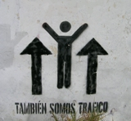
Pedestrian Safety Enforcement Training
Oregon Pedestrian Rights;
A Legal Guide for Persons on Foot
(We are traffic too)
Ray Thomas
©2018

Slide 3
Table of Contents
ORS Laws, including:
801.155, 801.220, 801.305, 801.320, 801.385, 801.440, 801.480, 801.485, 810.020, 811.005, 811.015, 811.020, 811.025, 811.028, 811.035, 811.060, 811.165, 811.233, 811.505, 811.550, 811.555, 811.560, 814.010, 814.020, 814.040, 814.060, 814.070, 814.110,
Photo Radar
ORS 810.438, 810.439
Violation Proceedings by Private Party
ORS 153.042 Citation Requirements for Enforcement Officer
ORS 153.058 Initiation of Violation Proceedings by Private Party
New ORS Effective 1/1/20
ORS 811.260 and 811.265 Bicycle Rider Allowed to Slow, Yield, and Roll at Stop Signs
ORS 801.155 Bike Lanes Continue Through Intersections
City and County Codes, including:
Albany Municipal Code, Ashland Municipal Code, Astoria City Code, Beaverton Municipal Code, Eugene City Code, Gresham Municipal Code, Milwaukie Municipal Code, Oregon City Municipal Code, Portland City Code, Sandy City Code, Scaoppoose Municipal Code of Ordinances, Springfield Municipal Code, St. Helens Municipal Code, Stayton City Code, Tigard Municipal Code, Troutdale City Ordinances, West Linn Municipal Code, Woodburn City Ordinances, Yamhill Active Municipal Code

Slide 4
Bicycle Lane – ORS 801.155
“Bicycle lane.” “Bicycle lane” means that part of the highway, adjacent to the roadway, designated by official signs or markings for use by persons riding bicycles except as otherwise specifically provided by law. [1983 c.338 §23]

Slide 5
Crosswalk – ORS 801.220
“Crosswalk” means any portion of a roadway at an intersection or elsewhere that is distinctly indicated for pedestrian crossing by lines or other markings on the surface of the roadway that conform in design to the standards established for crosswalks under ORS 810.200 (Uniform standards for traffic control devices). Whenever marked crosswalks have been indicated, such crosswalks and no other shall be deemed lawful across such roadway at that intersection. Where no marked crosswalk exists, a crosswalk is that portion of the roadway described in the following:
(1) Where sidewalks, shoulders or a combination thereof exists, a crosswalk is the portion of a roadway at an intersection, not more than 20 feet in width as measured from the prolongation of the lateral line of the roadway toward the prolongation of the adjacent property line, that is included within:
(a) The connections of the lateral lines of the sidewalks, shoulders or a combination thereof on opposite sides of the street or highway measured from the curbs or, in the absence of curbs, from the edges of the traveled roadway; or
(b) The prolongation of the lateral lines of a sidewalk, shoulder or both, to the sidewalk or shoulder on the opposite side of the street, if the prolongation would meet such sidewalk or shoulder.
(2) If there is neither sidewalk nor shoulder, a crosswalk is the portion of the roadway at an intersection, measuring not less than six feet in width, that would be included within the prolongation of the lateral lines of the sidewalk, shoulder or both on the opposite side of the street or highway if there were a sidewalk. [1983 c.338 §36]

Slide 6
Highway – ORS 801.305
(1) “Highway” means every public way, road, street, thoroughfare and place, including bridges, viaducts and other structures within the boundaries of this state, open, used or intended for use of the general public for vehicles or vehicular traffic as a matter of right.
(2) For the purpose of enforcing traffic offenses contained in the Oregon Vehicle Code, except for ORS 810.230 (Unlawful sign display), “highway” includes premises open to the public that are owned by a homeowners association and whose boundaries are contained within a service district established on or before July 1, 2002, under ORS 451.410 (Definitions for ORS 451.410 to 451.610) to 451.610 (Advisory committee for emergency communications system). [1983 c.338 §51; 2007 c.561 §1]

Slide 7
Intersection – ORS 801.320
“Intersection” means the area of a roadway created when two or more roadways join together at any angle, as described in one of the following:
(1) If the roadways have curbs, the intersection is the area embraced within the prolongation or connection of the lateral curb lines.
(2) If the roadways do not have curbs, the intersection is the area embraced within the prolongation or connection of the lateral boundary lines of the roadways.
(3) The junction of an alley with a roadway does not constitute an intersection.
(4) Where a highway includes two roadways 30 feet or more apart, then every crossing of each roadway of the divided highway by an intersection highway is a separate intersection. In the event the intersection highway also includes two roadways 30 feet or more apart, then every crossing of two roadways of such highways is a separate intersection. [1983 c.338 §53]

Slide 8
Pedestrian – ORS 801.385
“Pedestrian” means any person afoot or confined in a wheelchair. [1983 c.338 §69]

Slide 9
Right of way – ORS 801.440
“Right of way” means the right of one vehicle or pedestrian to proceed in a lawful manner in preference to another vehicle or pedestrian approaching under such circumstances of direction, speed and proximity as to give rise to danger of collision unless one grants precedence to the other. [1983 c.338 §81]

Slide 10
Roadway – ORS 801.450
“Roadway.” “Roadway” means the portion of a highway that is improved, designed or ordinarily used for vehicular travel, exclusive of the shoulder. In the event a highway includes two or more separate roadways the term “roadway” shall refer to any such roadway separately, but not to all such roadways collectively. [1983 c.338 §83]

Slide 11
Shoulder – ORS 801.480
“Shoulder” means the portion of a highway, whether paved or unpaved, contiguous to the roadway that is primarily for use by pedestrians, for the accommodation of stopped vehicles, for emergency use and for lateral support of base and surface courses. [1983 c.338 §88]

Slide 12
Sidewalk – ORS 801.485
“Sidewalk” means the area determined as follows:
(1) On the side of a highway which has a shoulder, a sidewalk is that portion of the highway between the outside lateral line of the shoulder and the adjacent property line capable of being used by a pedestrian.
(2) On the side of a highway which has no shoulder, a sidewalk is that portion of the highway between the lateral line of the roadway and the adjacent property line capable of being used by a pedestrian. [1983 c.338 §89]

Slide 13
Regulating use of throughway – ORS 810.020
Each road authority may prohibit or restrict the use of a throughway in its jurisdiction by any of the following:
(a) Parades.
(b) Bicycles or other nonmotorized traffic.
(c) Motorcycles or mopeds.
(2) Regulation under this section becomes effective when appropriate signs giving notice of the regulation are erected upon a throughway and the approaches to the throughway.
(3) Penalties for violation of restrictions or prohibitions imposed under this section are provided under ORS 811.445 (Use of throughway when prohibited).
(4) The Oregon Transportation Commission shall act as road authority under this section in lieu of the Department of Transportation. [1983 c.338 §146]

Slide 14
Duty to exercise due care – ORS 811.005
None of the provisions of the vehicle code relieve a pedestrian from the duty to exercise due care or relieve a driver from the duty to exercise due care concerning pedestrians. [1983 c.338 §543]

Slide 15
Failure to obey traffic patrol member; penalty- ORS 811.015
(1) The driver of a vehicle commits the offense of failure to obey a traffic patrol member if:
(a) A traffic patrol member makes a cautionary sign or signal to indicate that students have entered or are about to enter the crosswalk under the traffic patrol member’s direction; and
(b) The driver does not stop and remain stopped for students who are in or entering the crosswalk from either direction on the street on which the driver is operating.
(2) Traffic patrol members described in this section are those provided under ORS 339.650 (“Traffic patrol” defined for ORS 339.650 to 339.665) to 339.665 (Intergovernmental cooperation and assistance in connection with traffic patrols).
(3) The offense described in this section, failure to obey a traffic patrol member, is a Class A traffic violation. [1983 c.338 §545; 1995 c.383 §12; 2003 c.278 §2]

Slide 16
Passing stopped vehicle at crosswalk; penalty – ORS 811.020
(1) The driver of a vehicle commits the offense of passing a stopped vehicle at a crosswalk if the driver:
(a) Approaches from the rear another vehicle that is stopped at a marked or an unmarked crosswalk at an intersection to permit a pedestrian to cross the roadway; and
(b) Overtakes and passes the stopped vehicle.
(2) The offense described in this section, passing a stopped vehicle at a crosswalk, is a Class B traffic violation. [1983 c.338 §546]

Slide 17
Failure to yield to pedestrian on sidewalk; penalty – ORS 811.025
(1) The driver of a vehicle commits the offense of failure to yield to a pedestrian on a sidewalk if the driver does not yield the right of way to any pedestrian on a sidewalk.
(2) The offense described in this section, failure to yield to a pedestrian on a sidewalk, is a Class B traffic violation. [1983 c.338 §547; 1995 c.383 §42]

Slide 18
Failure to stop and remain stopped for pedestrian; penalty – ORS 811.028
(1) The driver of a vehicle commits the offense of failure to stop and remain stopped for a pedestrian if the driver does not stop and remain stopped for a pedestrian when the pedestrian is:
(a) Proceeding in accordance with a traffic control device as provided under ORS 814.010 (Appropriate responses to traffic control devices) or crossing the roadway in a crosswalk; and
(b) In any of the following locations:
(A) In the lane in which the driver’s vehicle is traveling;
(B) In a lane adjacent to the lane in which the driver’s vehicle is traveling;
(C) In the lane into which the driver’s vehicle is turning;
(D) In a lane adjacent to the lane into which the driver’s vehicle is turning, if the driver is making a turn at an intersection that does not have a traffic control device under which a pedestrian may proceed as provided under ORS 814.010 (Appropriate responses to traffic control devices); or
(E) Less than six feet from the lane into which the driver’s vehicle is turning, if the driver is making a turn at an intersection that has a traffic control device under which a pedestrian may proceed as provided under ORS 814.010 (Appropriate responses to traffic control devices).
(2) For the purpose of this section, a bicycle lane or the part of a roadway where a vehicle stops, stands or parks that is adjacent to a lane of travel is considered to be part of that adjacent lane of travel.
(3) This section does not require a driver to stop and remain stopped for a pedestrian under any of the following circumstances:
(a) Upon a roadway with a safety island, if the driver is proceeding along the half of the roadway on the far side of the safety island from the pedestrian; or
(b) Where a pedestrian tunnel or overhead crossing has been provided at or near a crosswalk.
(4) For the purposes of this section, a pedestrian is crossing the roadway in a crosswalk when any part or extension of the pedestrian, including but not limited to any part of the pedestrian’s body, wheelchair, cane, crutch or bicycle, moves onto the roadway in a crosswalk with the intent to proceed.
(5) The offense described in this section, failure to stop and remain stopped for a pedestrian, is a Class B traffic violation. [2005 c.746 §2; 2011 c.507 §1]

Slide 19
Failure to stop and remain stopped for blind pedestrian; penalty – ORS 811.035
(1) The driver of a vehicle commits the offense of failure to stop and remain stopped for a pedestrian who has limited vision or a pedestrian who is blind if the driver violates any of the following:
(a) A driver approaching a pedestrian who has limited vision or a pedestrian who is blind or deaf-blind, who is carrying a white cane or accompanied by a dog guide, and who is crossing or about to cross a roadway, shall stop and remain stopped until the pedestrian has crossed the roadway.
(b) Where the movement of vehicular traffic is regulated by traffic control devices, a driver approaching a pedestrian who has limited vision or a pedestrian who is blind or deaf-blind shall stop and remain stopped until the pedestrian has vacated the roadway if the pedestrian has entered the roadway and is carrying a white cane or is accompanied by a dog guide. This paragraph applies notwithstanding any other provisions of the vehicle code relating to traffic control devices.
(2) This section is subject to the provisions and definitions relating to the rights of pedestrians who have limited vision or pedestrians who are blind or deaf-blind under ORS 814.110 (Rights for persons who are blind, who are deaf-blind or who have limited vision).
(3) For the purposes of this section, a pedestrian is crossing the roadway when any part or extension of the pedestrian, including but not limited to any part of the pedestrian’s body, wheelchair, cane, crutch, bicycle or leashed animal, moves onto the roadway with the intent to proceed.
(4) The offense described in this section, failure to stop and remain stopped for a pedestrian who has limited vision or a pedestrian who is blind, is a Class B traffic violation. [1983 c.338 §549; 1985 c.16 §280; 2003 c.278 §3; 2007 c.70 §329; 2011 c.507 §2; 2017 c.175 §3]

Slide 20
Vehicular assault of bicyclist or pedestrian; penalty – ORS 811.060
(1) For the purposes of this section, “recklessly” has the meaning given that term in ORS 161.085 (Definitions with respect to culpability).
(2) A person commits the offense of vehicular assault if:
(a) The person recklessly operates a vehicle upon a highway in a manner that results in contact between the person’s vehicle and:
(A) A bicycle operated by a person;
(B) A person operating a bicycle;
(C) A motorcycle operated by a person;
(D) A person operating a motorcycle;
(E) A passenger on a motorcycle; or
(F) A pedestrian; and
(b) The contact causes physical injury to the person operating a bicycle, the person operating a motorcycle, the passenger on a motorcycle or the pedestrian.
(3) The offense described in this section, vehicular assault, is a Class A misdemeanor. [2001 c.635 §5; 2017 c.388 §1]

Slide 21
Failure to stop for passenger loading of public transit vehicle; penalty – ORS 811.165
(1) A person commits the offense of failure to stop for passenger loading of a public transit vehicle if the person is the driver of a vehicle overtaking a public transit vehicle described in this section that is stopped or about to stop for the purpose of receiving or discharging any passenger and the person does not:
(a) Stop the overtaking vehicle to the rear of the nearest running board or door of the public transit vehicle; and
(b) Keep the vehicle stationary until all passengers have boarded or alighted therefrom and reached a place of safety.
(2) This section applies to the following public transit vehicles:
(a) Commercial buses; and
(b) Rail fixed guideway public transportation system vehicles.
(3) A person is not in violation of this section if the person passes a public transit vehicle:
(a) Upon the left of any public transit vehicle described in this section on a one-way street; or
(b) At a speed not greater than is reasonable and proper and with due caution for the safety of pedestrians when:
(A) The public transit vehicle has stopped at the curb; or
(B) Any area or space has been officially set apart within the roadway for the exclusive use of pedestrians and the area or space is so protected or marked or indicated by adequate signs as to be plainly visible at all times while set apart as a safety zone.
(4) The offense described in this section, failure to stop for passenger loading of public transit vehicle, is a Class B traffic violation. [1983 c.338 §586; 1985 c.16 §292; 1995 c.383 §49; 2001 c.522 §4; 2017 c.46 §5]

Slide 22
Failure to yield right of way to highway worker; penalty – ORS 811.233
(1) A person commits the offense of failure to yield the right of way to a highway worker who is a pedestrian if the person is operating a motor vehicle in a highway work zone and does not yield the right of way to a highway worker who is a pedestrian.
(2) The provisions of ORS 814.040 (Failure to yield to vehicle) and 814.070 (Improper position upon or improperly proceeding along highway) regarding pedestrians do not apply to pedestrians described in subsection (1) of this section.
(3) The offense described in this section, failure to yield the right of way to a highway worker who is a pedestrian, is a Class B traffic violation. [1997 c.843 §2]

Slide 23
Failure to stop when emerging from alley, driveway or building; penalty – ORS 811.505
(1) A person commits the offense of failure to stop when emerging from an alley, driveway or building if the person is operating a vehicle that is emerging from an alley, building, private road or driveway in a business or residence district and the person does not stop the vehicle as follows:
(a) If there is a sidewalk or sidewalk area, the person must stop the vehicle before driving onto the sidewalk or sidewalk area.
(b) If there is no sidewalk or sidewalk area, the person must stop at the point nearest the roadway to be entered where the driver has a view of approaching traffic.
(2) The offense described in this section, failure to stop when emerging from an alley, driveway or building, is a Class B traffic violation. [1983 c.338 §658; 1985 c.16 §322; 1995 c.383 §78]

Slide 24
Places where stopping, standing and parking prohibited – ORS 811.550 (Part 1/3)
(1) Upon a roadway outside a business district or residence district, whether attended or unattended, when it is practicable to stop, park or leave the vehicle standing off the roadway. Exemptions under ORS 811.560 (Exemptions from prohibitions on stopping, standing or parking) (1), (7) and (9) are applicable to this subsection.
(2) On a shoulder, whether attended or unattended, unless a clear and unobstructed width of the roadway opposite the standing vehicle is left for the passage of other vehicles and the standing vehicle is visible from a distance of 200 feet in each direction upon the roadway or the person, at least 200 feet in each direction upon the roadway, warns approaching motorists of the standing vehicle by use of flaggers, flags, signs or other signals. Exemptions under ORS 811.560 (Exemptions from prohibitions on stopping, standing or parking) (9) are applicable to this subsection.
(3) On the roadway side of a vehicle stopped or parked at the edge or curb of a highway. Exemptions under ORS 811.560 (Exemptions from prohibitions on stopping, standing or parking) (7) are applicable to this subsection.
(4) On a sidewalk. Exemptions under ORS 811.560 (Exemptions from prohibitions on stopping, standing or parking) (4) to (7) are applicable to this subsection.
(5) Within an intersection. Exemptions under ORS 811.560 (Exemptions from prohibitions on stopping, standing or parking) (4) to (7) are applicable to this subsection.
(6) On a crosswalk. Exemptions under ORS 811.560 (Exemptions from prohibitions on stopping, standing or parking) (4) to (7) are applicable to this subsection.
(7) Between a safety zone and the adjacent curb or within 30 feet of points on the curb immediately opposite the ends of a safety zone, unless a different length is indicated by signs and markings. For purposes of this subsection the safety zone must be an area or space officially set apart within a roadway for the exclusive use of pedestrians and which is protected or is so marked or indicated by adequate signs as to be plainly visible at all times while set apart as a safety zone. Exemptions under ORS 811.560 (Exemptions from prohibitions on stopping, standing or parking) (4) to (7) are applicable to this subsection.
(8) Alongside or opposite a street excavation or obstruction when stopping, standing or parking would obstruct traffic. Exemptions under ORS 811.560 (Exemptions from prohibitions on stopping, standing or parking) (4) to (7) are applicable to this subsection.

Slide 25
Places where stopping, standing and parking prohibited – ORS 811.550 (Part 2/3)
(9) Upon a bridge or other elevated structure upon a highway. Exemptions under ORS 811.560 (Exemptions from prohibitions on stopping, standing or parking) (4) to (8) are applicable to this subsection.
(10) Within a highway tunnel. Exemptions under ORS 811.560 (Exemptions from prohibitions on stopping, standing or parking) (4) to (7) are applicable to this subsection.
(11) On any railroad or rail fixed guideway public transportation system tracks or within seven and one-half feet of the nearest rail at a time when the parking of vehicles would conflict with operations or repair of the tracks. Exemptions under ORS 811.560 (Exemptions from prohibitions on stopping, standing or parking) (4) to (7) are applicable to this subsection.
(12) On a throughway. Exemptions under ORS 811.560 (Exemptions from prohibitions on stopping, standing or parking) (4) to (7) are applicable to this subsection.
(13) In the area between roadways of a divided highway, including crossovers. Exemptions under ORS 811.560 (Exemptions from prohibitions on stopping, standing or parking) (4) to (7) are applicable to this subsection.
(14) At any place where traffic control devices prohibit stopping. Exemptions under ORS 811.560 (Exemptions from prohibitions on stopping, standing or parking) (4) to (7) are applicable to this subsection.
(15) In front of a public or private driveway. Exemptions under ORS 811.560 (Exemptions from prohibitions on stopping, standing or parking) (2) and (4) to (7) are applicable to this subsection.
(16) Within 10 feet of a fire hydrant. Exemptions under ORS 811.560 (Exemptions from prohibitions on stopping, standing or parking) (2) and (4) to (7) are applicable to this subsection.
(17) Within 20 feet of a crosswalk at an intersection. Exemptions under ORS 811.560 (Exemptions from prohibitions on stopping, standing or parking) (2) and (4) to (7) are applicable to this subsection.

Slide 26
Places where stopping, standing and parking prohibited – ORS 811.550 (Part 3/3)
(18) Within 50 feet upon the approach to an official flashing signal, stop sign, yield sign or traffic control device located at the side of the roadway if the standing or parking of a vehicle will obstruct the view of any traffic control device located at the side of the roadway. Exemptions under ORS 811.560 (Exemptions from prohibitions on stopping, standing or parking) (2) and (4) to (7) are applicable to this subsection.
(19) Within 15 feet of the driveway entrance to a fire station and on the side of a street opposite the entrance to a fire station, within 75 feet of the entrance. Exemptions under ORS 811.560 (Exemptions from prohibitions on stopping, standing or parking) (2) and (4) to (7) are applicable to this subsection.
(20) At any place where traffic control devices prohibit standing. Exemptions under ORS 811.560 (Exemptions from prohibitions on stopping, standing or parking) (2) and (4) to (7) are applicable to this subsection.
(21) Within 50 feet of the nearest rail of a railroad or rail fixed guideway public transportation system crossing. Exemptions under ORS 811.560 (Exemptions from prohibitions on stopping, standing or parking) (3) to (7) are applicable to this subsection.
(22) At any place where traffic control devices prohibit parking. Exemptions under ORS 811.560 (Exemptions from prohibitions on stopping, standing or parking) (3) to (7) are applicable to this subsection.
(23) On a bicycle lane. Exemptions under ORS 811.560 (Exemptions from prohibitions on stopping, standing or parking) are applicable to this subsection.
(24) On a bicycle path. Exemptions under ORS 811.560 (Exemptions from prohibitions on stopping, standing or parking) are applicable to this subsection. [1983 c.338 §669; 1985 c.21 §1; 1985 c.334 §1; 1989 c.433 §2; 1997 c.249 §234; 2001 c.522 §9; 2017 c.46 §10]

Slide 27
Illegal stopping, standing or parking; affirmative defense; penalty – ORS 811.555
(1) A person commits the offense of illegal stopping, standing or parking if:
(a) The person stops, parks or leaves standing a vehicle in a place where such stopping, parking or standing is prohibited under ORS 811.550 (Places where stopping, standing and parking prohibited); or
(b) The person is the owner of an unattended vehicle parked in a place where such parking is prohibited under ORS 811.550 (Places where stopping, standing and parking prohibited).
(2) Exemptions from this section are established under ORS 811.560 (Exemptions from prohibitions on stopping, standing or parking).
(3) A police officer, under authority granted by ORS 810.430 (Movement of illegally parked vehicles), may move or require to be moved a vehicle that is stopped, parked or left standing in violation of this section.
(4) It is an affirmative defense to a prosecution of the owner of a vehicle under subsection (1)(b) of this section that the use of the vehicle was not authorized by the owner, either expressly or by implication.
(5) The offense described by this section, illegal stopping, standing or parking, is a Class D traffic violation. [1983 c.338 §668; 1987 c.687 §4]

Slide 28
Exemptions from prohibitions on stopping, standing and parking – ORS 811.560 (Part 1/2)
(1) When applicable, this subsection exempts school buses or worker transport buses stopped on a roadway to load or unload workers or children, providing that the flashing school bus safety lights on the bus are operating.
(2) When applicable, this subsection exempts vehicles stopped, standing or parked momentarily to pick up or discharge a passenger.
(3) When applicable, this subsection exempts vehicles stopped, standing or parked momentarily for the purpose of and while actually engaged in loading or unloading property or passengers.
(4) When applicable, this subsection exempts vehicles owned or operated by the state, a county or city when stopping, standing or parking is necessary to perform maintenance or repair work on the roadway.
(5) When applicable, this subsection exempts vehicles from the prohibitions and penalties when the driver’s disregard of the prohibitions is necessary to avoid conflict with other traffic.

Slide 29
Exemptions from prohibitions on stopping, standing and parking – ORS 811.560 (Part 2/2)
(6) When applicable, this subsection exempts vehicles acting in compliance with law or at the direction of a police officer or a traffic control device.
(7) When applicable, this subsection exempts the driver of a vehicle that is disabled in such manner and to such extent that the driver cannot avoid stopping or temporarily leaving the disabled vehicle in a prohibited position.
(8) When applicable, this subsection exempts vehicles owned or operated by the State Department of Fish and Wildlife when stopping, standing or parking is necessary to enable employees to release fish.
(9) When applicable, this subsection exempts vehicles momentarily stopped to allow oncoming traffic to pass before making a right-hand or left-hand turn or momentarily stopped in preparation for or while negotiating an exit from the road.
(10) When applicable, this subsection exempts commercial vehicles that are stopped, standing or parked when stopping, standing or parking is necessary to engage in any activity associated with the collection of solid waste, recyclable material or yard debris, as those terms are defined in ORS 459.005 (Definitions for ORS 459.005 to 459.437, 459.705 to 459.790 and 459A.005 to 459A.665). [1983 c.338 §670; 1985 c.334 §2; 1989 c.433 §3; 2013 c.250 §1]

Slide 30
Appropriate responses to traffic control devices – ORS 814.010 (Part 1/2)
(1) A pedestrian facing a traffic control device with a green light may proceed across the roadway within any marked or unmarked crosswalk unless prohibited from doing so by other traffic control devices.
(2) A pedestrian facing a traffic control device with a green arrow signal light may proceed across the roadway within any marked or unmarked crosswalk unless prohibited from doing so by other traffic control devices.
(3) A pedestrian facing a traffic control device with a steady yellow light shall not enter the roadway unless otherwise directed by a pedestrian control signal.
(4) A pedestrian facing a traffic control device with a steady red light shall not enter the roadway unless otherwise directed by a pedestrian control signal.

Slide 31
Appropriate responses to traffic control devices – ORS 814.010 (Part 2/2)
(5) If a traffic control device is erected and maintained at a place other than an intersection, the provisions of this section are applicable.
(6) When a pedestrian control signal showing the words “Walk” and “Wait” or “Don’t Walk” or any other pedestrian symbol approved by the Oregon Transportation Commission under ORS 810.200 (Uniform standards for traffic control devices) and 810.210 (Placement and control of traffic control devices) for the purpose of controlling pedestrian crossing is in place, the signal indicates and applies as follows:
(a) If a pedestrian is facing a “Walk” signal or other symbol approved under ORS 810.200 (Uniform standards for traffic control devices) and 810.210 (Placement and control of traffic control devices) indicating that the pedestrian may proceed, the pedestrian may proceed across the roadway in the direction of the signal.
(b) A pedestrian shall not start to cross the roadway in the direction of a signal showing a “Wait” or “Don’t Walk” or any other symbol approved under ORS 810.200 (Uniform standards for traffic control devices) and 810.210 (Placement and control of traffic control devices) indicating that the pedestrian may not proceed. A pedestrian who has started crossing a roadway on a signal showing “Walk” or any other approved symbol to proceed shall proceed with dispatch to a sidewalk or safety island while a signal is showing “Wait” or “Don’t Walk” or any other approved symbol indicating not to proceed. [1983 c.338 §553; 1985 c.16 §282]

Slide 32
Failure to obey traffic control device; penalty – ORS 814.020
(1) A pedestrian commits the offense of pedestrian failure to obey traffic control devices if the pedestrian does any of the following:
(a) Fails to obey any traffic control device specifically applicable to the pedestrian
(b) Fails to obey any specific traffic control device described in ORS 814.010 (Appropriate responses to traffic control devices) in the manner required by that section.
(2) A pedestrian is not subject to the requirements of this section if the pedestrian complies with directions of a police officer.
(3) The offense described in this section, pedestrian failure to obey traffic control devices, is a Class D traffic violation. [1983 c.338 §552; 1995 c.383 §82]

Slide 33
Failure to yield to vehicle; penalty – ORS 814.040
(1) A pedestrian commits the offense of pedestrian failure to yield to a vehicle if the pedestrian does any of the following:
(a) Suddenly leaves a curb or other place of safety and moves into the path of a vehicle that is so close as to constitute an immediate hazard.
(b) Fails to yield the right of way to a vehicle upon a roadway when the pedestrian is crossing the roadway at any point other than within a marked crosswalk or an unmarked crosswalk at an intersection.
(c) Except as otherwise provided under the vehicle code, fails to yield the right of way to all vehicles upon the roadway.
(2) The offense described in this section, pedestrian failure to yield to a vehicle, is a Class D traffic violation. [1983 c.338 §555; 1995 c.383 §84]

Slide 34
Failure to use pedestrian tunnel or overheard crossing; penalty – ORS 814.060
(1) A pedestrian commits the offense of failure to use pedestrian tunnel or overhead crossing if the pedestrian crosses a roadway other than by means of a pedestrian tunnel or overhead pedestrian crossing when a tunnel or overhead crossing serves the place where the pedestrian is crossing the roadway.
(2) The offense described in this section, failure to use pedestrian tunnel or overhead crossing, is a Class D traffic violation. [1983 c.338 §557]

Slide 35
Improper position upon or improperly proceeding along highway; penalty – ORS 814.070 (Part 1/2)
(1) A pedestrian commits the offense of pedestrian with improper position upon or improperly proceeding along a highway if the pedestrian does any of the following:
(a) Takes a position upon or proceeds along and upon the roadway where there is an adjacent usable sidewalk or shoulder.
(b) Does not take a position upon or proceed along and upon the shoulder, as far as practicable from the roadway edge, on a highway that has an adjacent shoulder area on one or both sides.
(c) Except in the case of the divided highway, does not take a position upon or proceed along and upon the left shoulder and as far as practicable from the roadway edge on a two-way highway that has no sidewalk and that does have an adjacent shoulder area. This paragraph does not apply to:
(A) A hitchhiker who takes a position upon or proceeds along and upon the right shoulder so long as the hitchhiker does so facing the vehicles using the adjacent lane of the roadway; or
(B) A member of a group that has adopted that section of highway under the provisions of ORS 366.158 (Adopt-a-Highway Program) who is obeying the rules of the Department of Transportation for picking up litter or removing noxious weeds on either side of the roadway.
(d) Does not take a position upon or proceed along and upon the right highway shoulder, as far as practicable from the roadway edge, on a divided highway that has no sidewalk and does have a shoulder area. This paragraph does not apply to a member of a group that has adopted that section of highway under the provisions of ORS 366.158 (Adopt-a-Highway Program) who is obeying the rules of the Department of Transportation for picking up litter or removing noxious weeds on either side of the roadway.
(e) Fails to take a position upon or proceed along and upon a highway that has neither sidewalk nor shoulder available, as near as practicable to an outside edge of the roadway, and, if the roadway is a two-way roadway, only on the left side of it.
(2) This section is subject to the provisions of ORS 814.100 (Rights of driver and passengers of disabled vehicle on freeway).

Slide 36
Improper position upon or improperly proceeding along highway; penalty – 814.070 (Part 2/2)
(3) A pedestrian does not commit the offense of pedestrian with improper position upon or improperly proceeding along a highway if the pedestrian:
(a) Does not impede traffic or create a traffic hazard;
(b) Posts advance warning signs in compliance with standards adopted by the Oregon Transportation Commission under ORS 810.200 (Uniform standards for traffic control devices);
(c) Wears high-visibility safety apparel in compliance with standards adopted by the Oregon Transportation Commission under ORS 810.200 (Uniform standards for traffic control devices); and
(d) Has a permit or belongs to a group that has a permit issued under ORS 814.072 (Issuance of permit to be upon or to proceed along highway).
(4) A pedestrian does not commit the offense of pedestrian with improper position upon or improperly proceeding along a highway when the pedestrian is on a narrow residential roadway if:
(a) The pedestrian does not create a traffic hazard; and
(b) Signs are posted giving notice that pedestrians may be present upon or along the narrow residential roadway. Signs posted under this paragraph shall be posted at each end of the portion of the narrow residential roadway where pedestrians may be present.
(5) The offense described in this section, pedestrian with improper position upon or improperly proceeding along a highway, is a Class D traffic violation. [1983 c.338 §558; 1991 c.486 §4; 1995 c.383 §86; 2008 c.47 §§1,2; 2009 c.547 §§2,3; 2011 c.507 §3; 2013 c.474 §1]

Slide 37
Rights for blind or blind and deaf pedestrians – ORS 814.110
(1) The following definitions apply to this section and to ORS 811.035 (Failure to stop and remain stopped for pedestrian who has limited vision or is blind) and 814.120 (Unlawful use of white cane):
(a) “Blind” means visual acuity that does not exceed 20/200 in the better eye with corrective lenses, or having a visual field of 20 degrees or less.
(b) “Dog guide” means a dog that is wearing a dog guide harness and is trained to lead or guide a person who is blind.
(c) “Limited vision” means visual acuity that does not exceed 20/70 and is no worse than 20/200 in the better eye with corrective lenses.
(d) “White cane” means a cane or walking stick that is white in color or white with a red tip.
(2) This section and ORS 811.035 (Failure to stop and remain stopped for pedestrian who has limited vision or is blind) and 814.120 (Unlawful use of white cane) grant and enforce the following rights for pedestrians who are blind or deaf-blind:
(a) A person who has limited vision and a person who is blind or deaf-blind may carry and use a white cane on the highways and other public places of this state for the purposes of identification and mobility.
(b) A person who has limited vision and a person who is deaf-blind may use a white cane marked by a six-inch-wide chartreuse-colored strip at the tip end.
(3) A pedestrian who has limited vision and a pedestrian who is blind or deaf-blind and who is not carrying a white cane or not accompanied by a dog guide has all the rights and privileges granted by law to all pedestrians. [1985 c.16 §284; 2007 c.70 §344; 2017 c.175 §1]

Slide 38
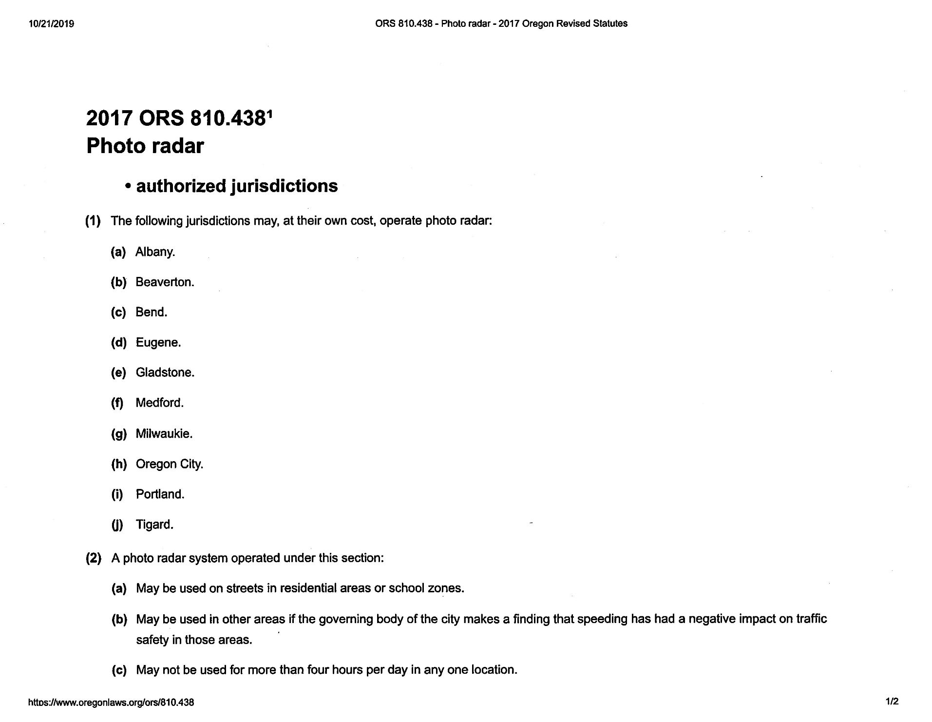

Slide 39
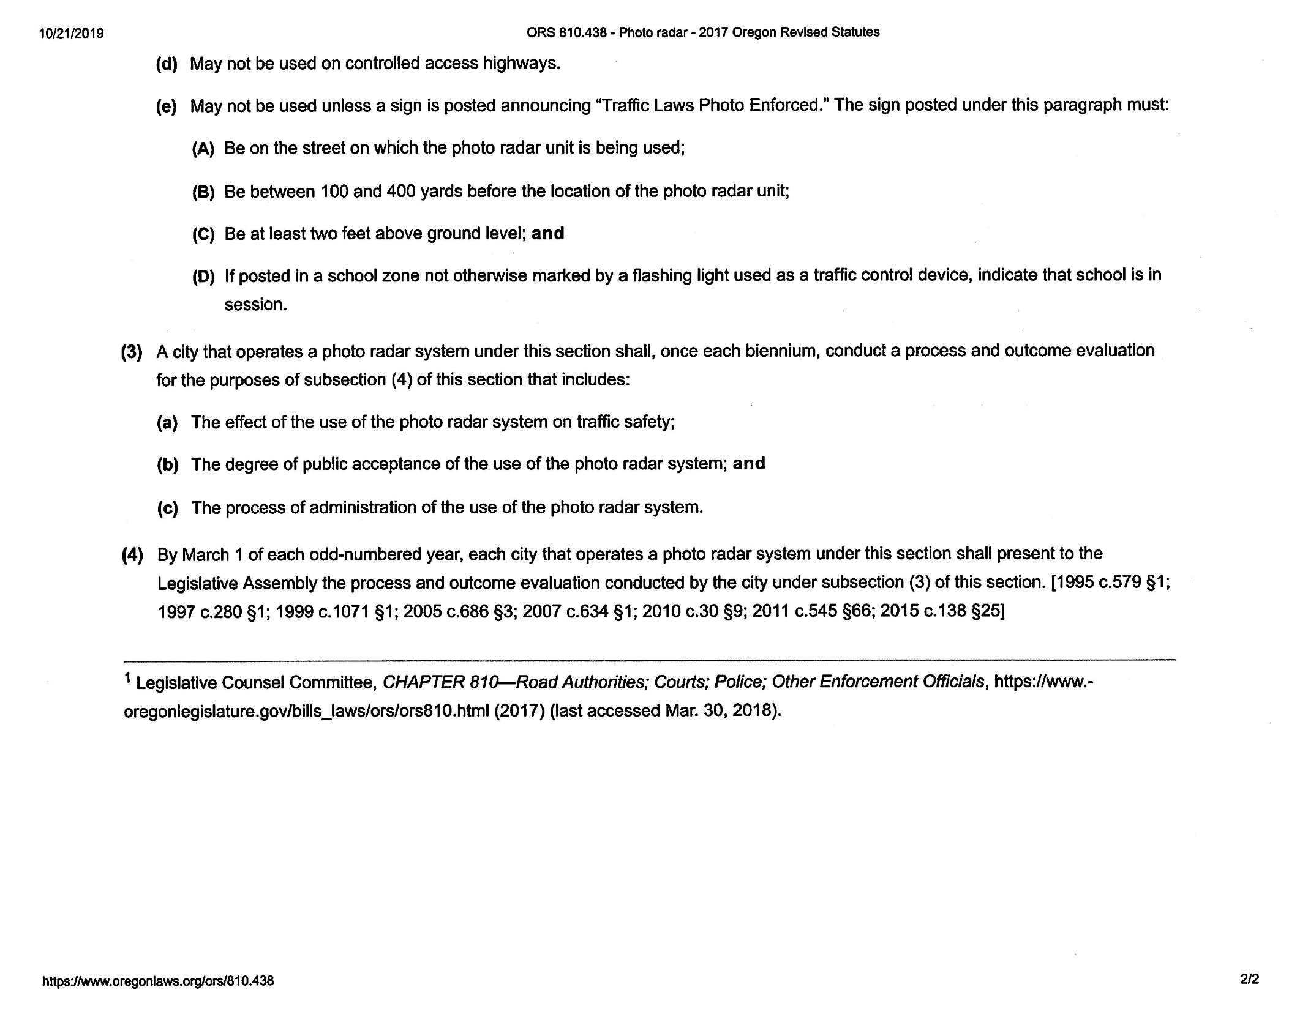

Slide 40
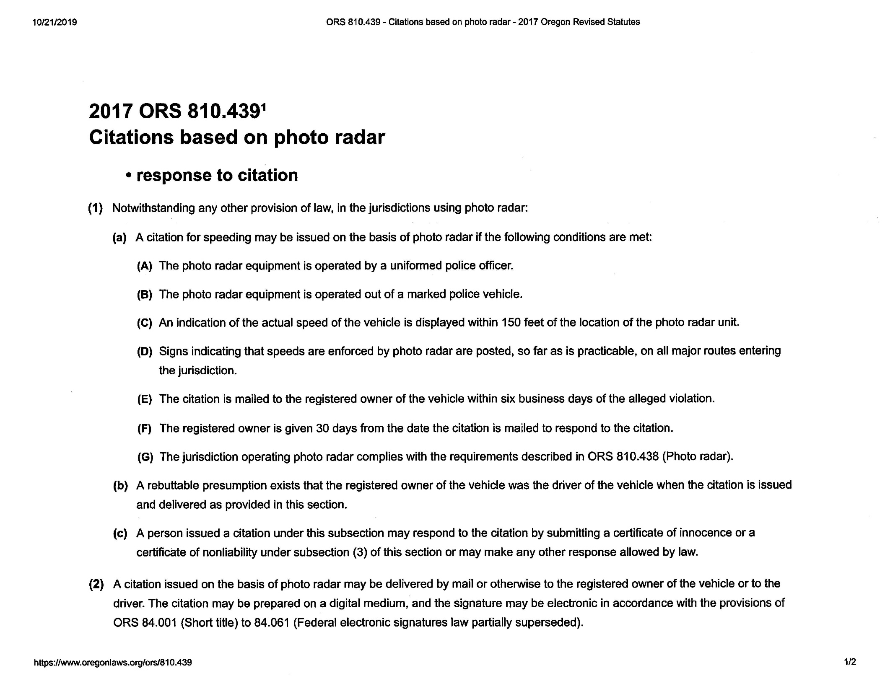

Slide 41
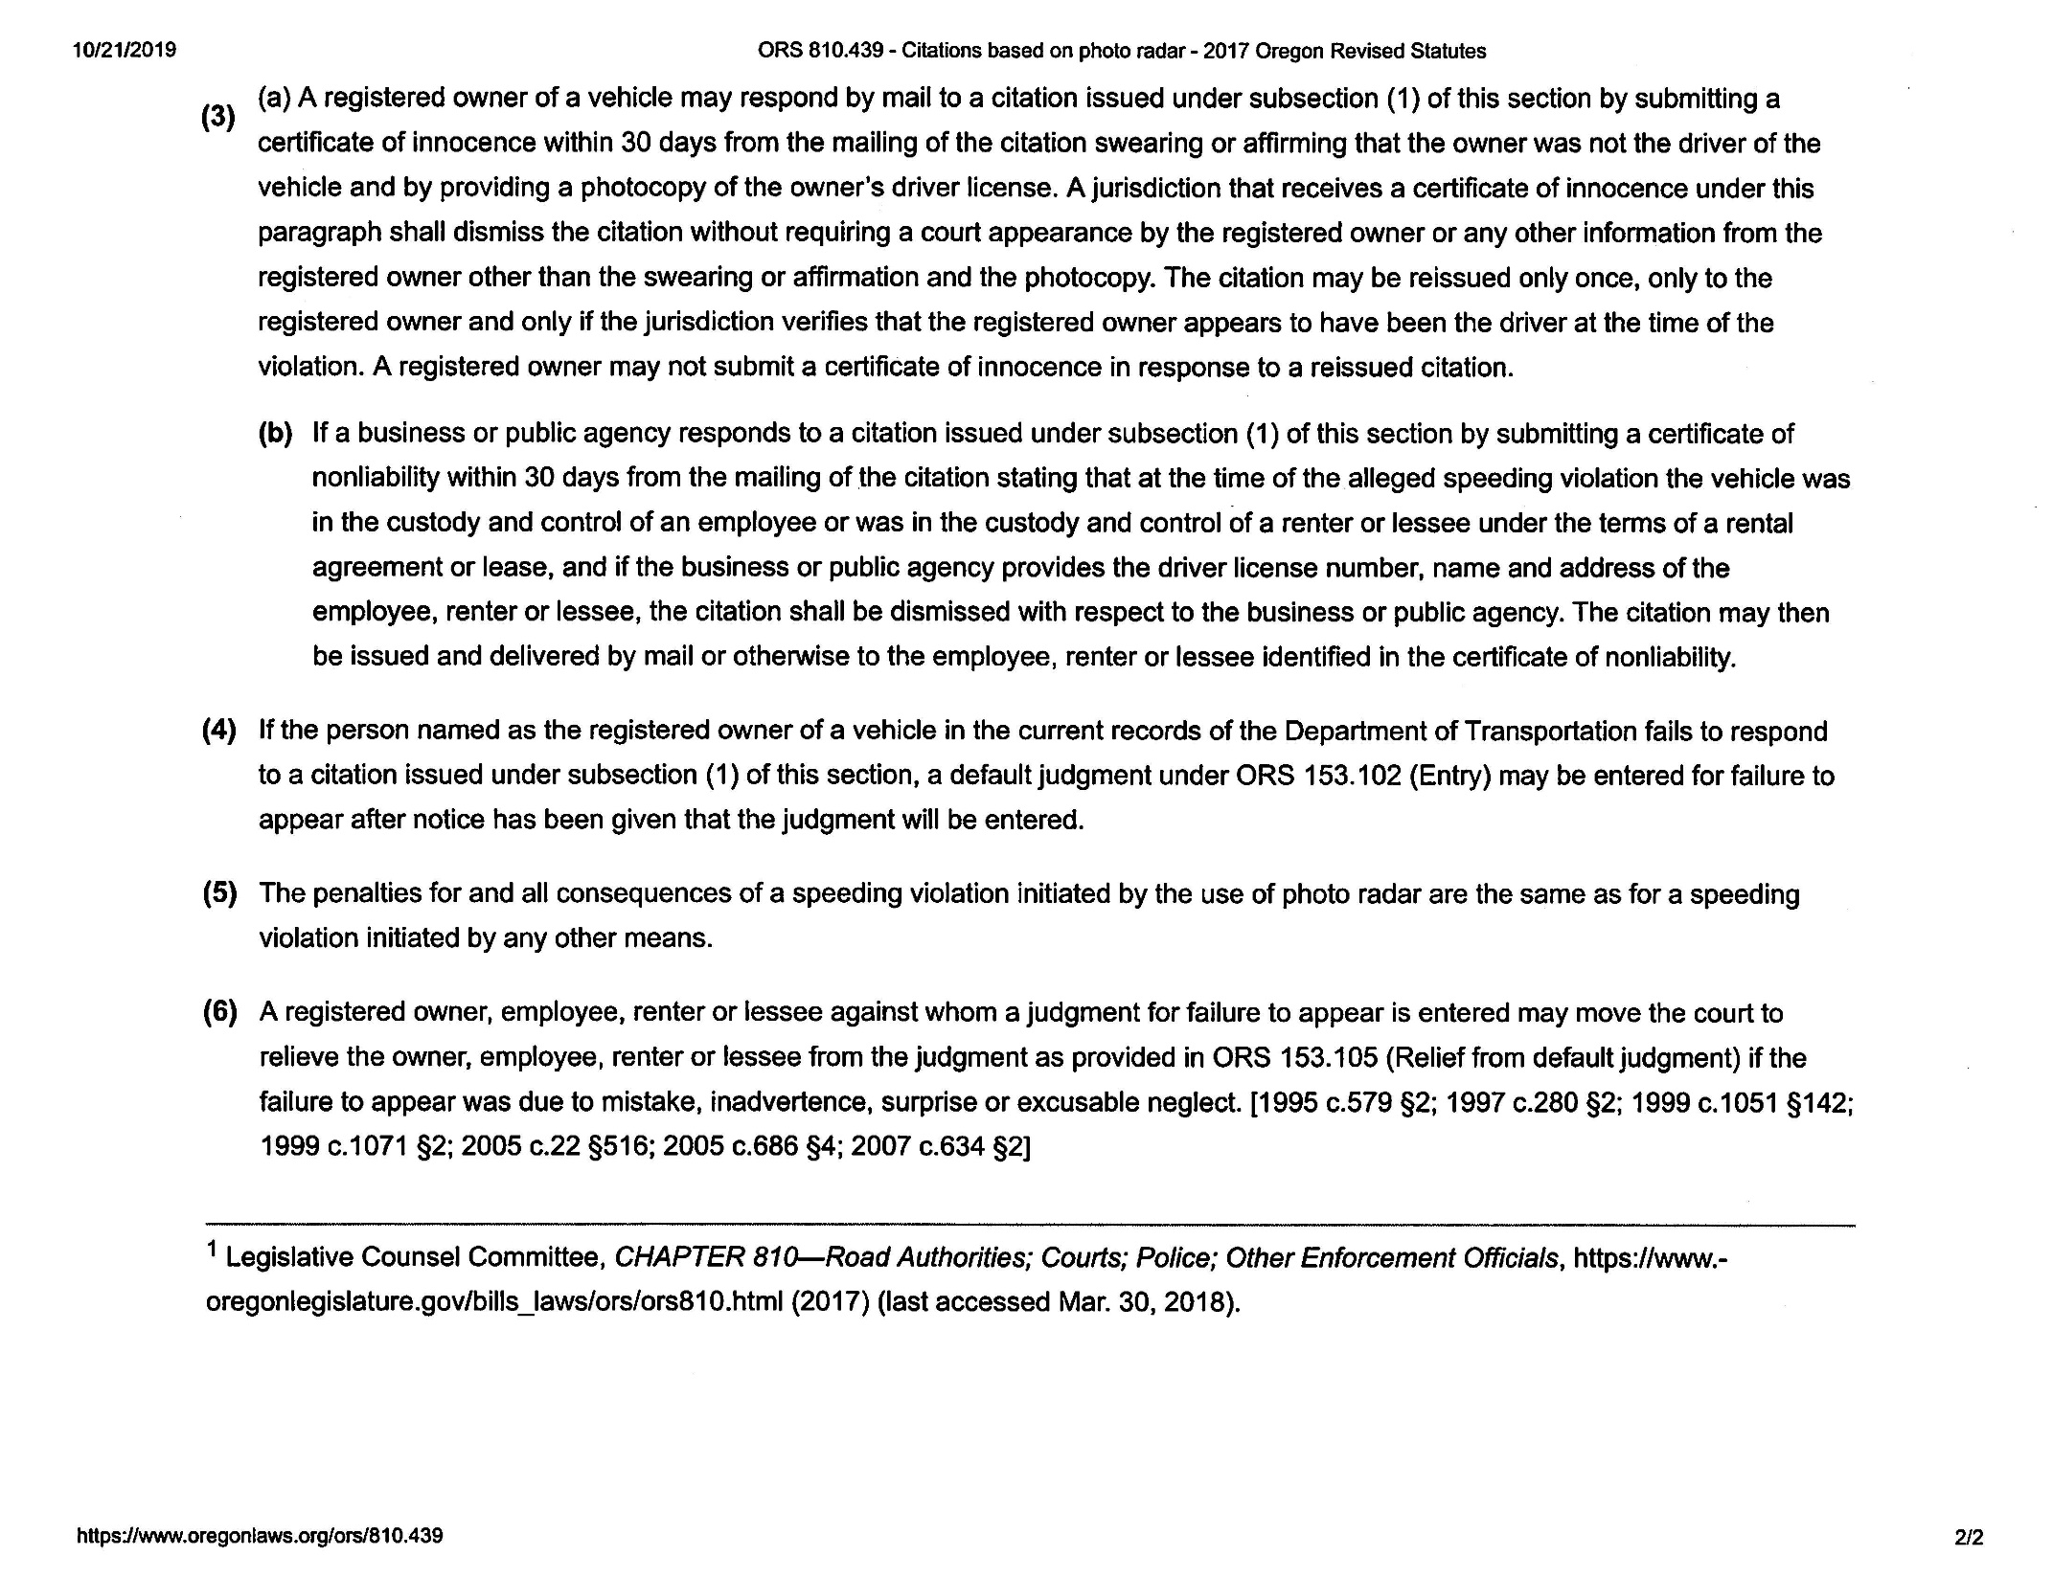

Slide 42
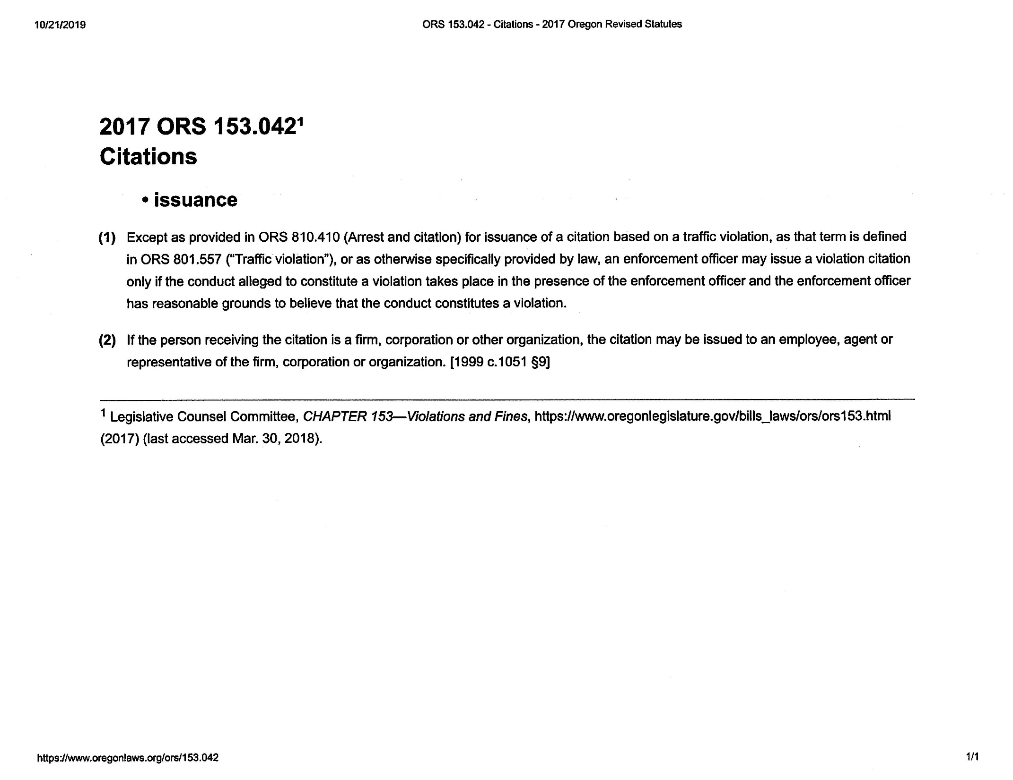

Slide 43
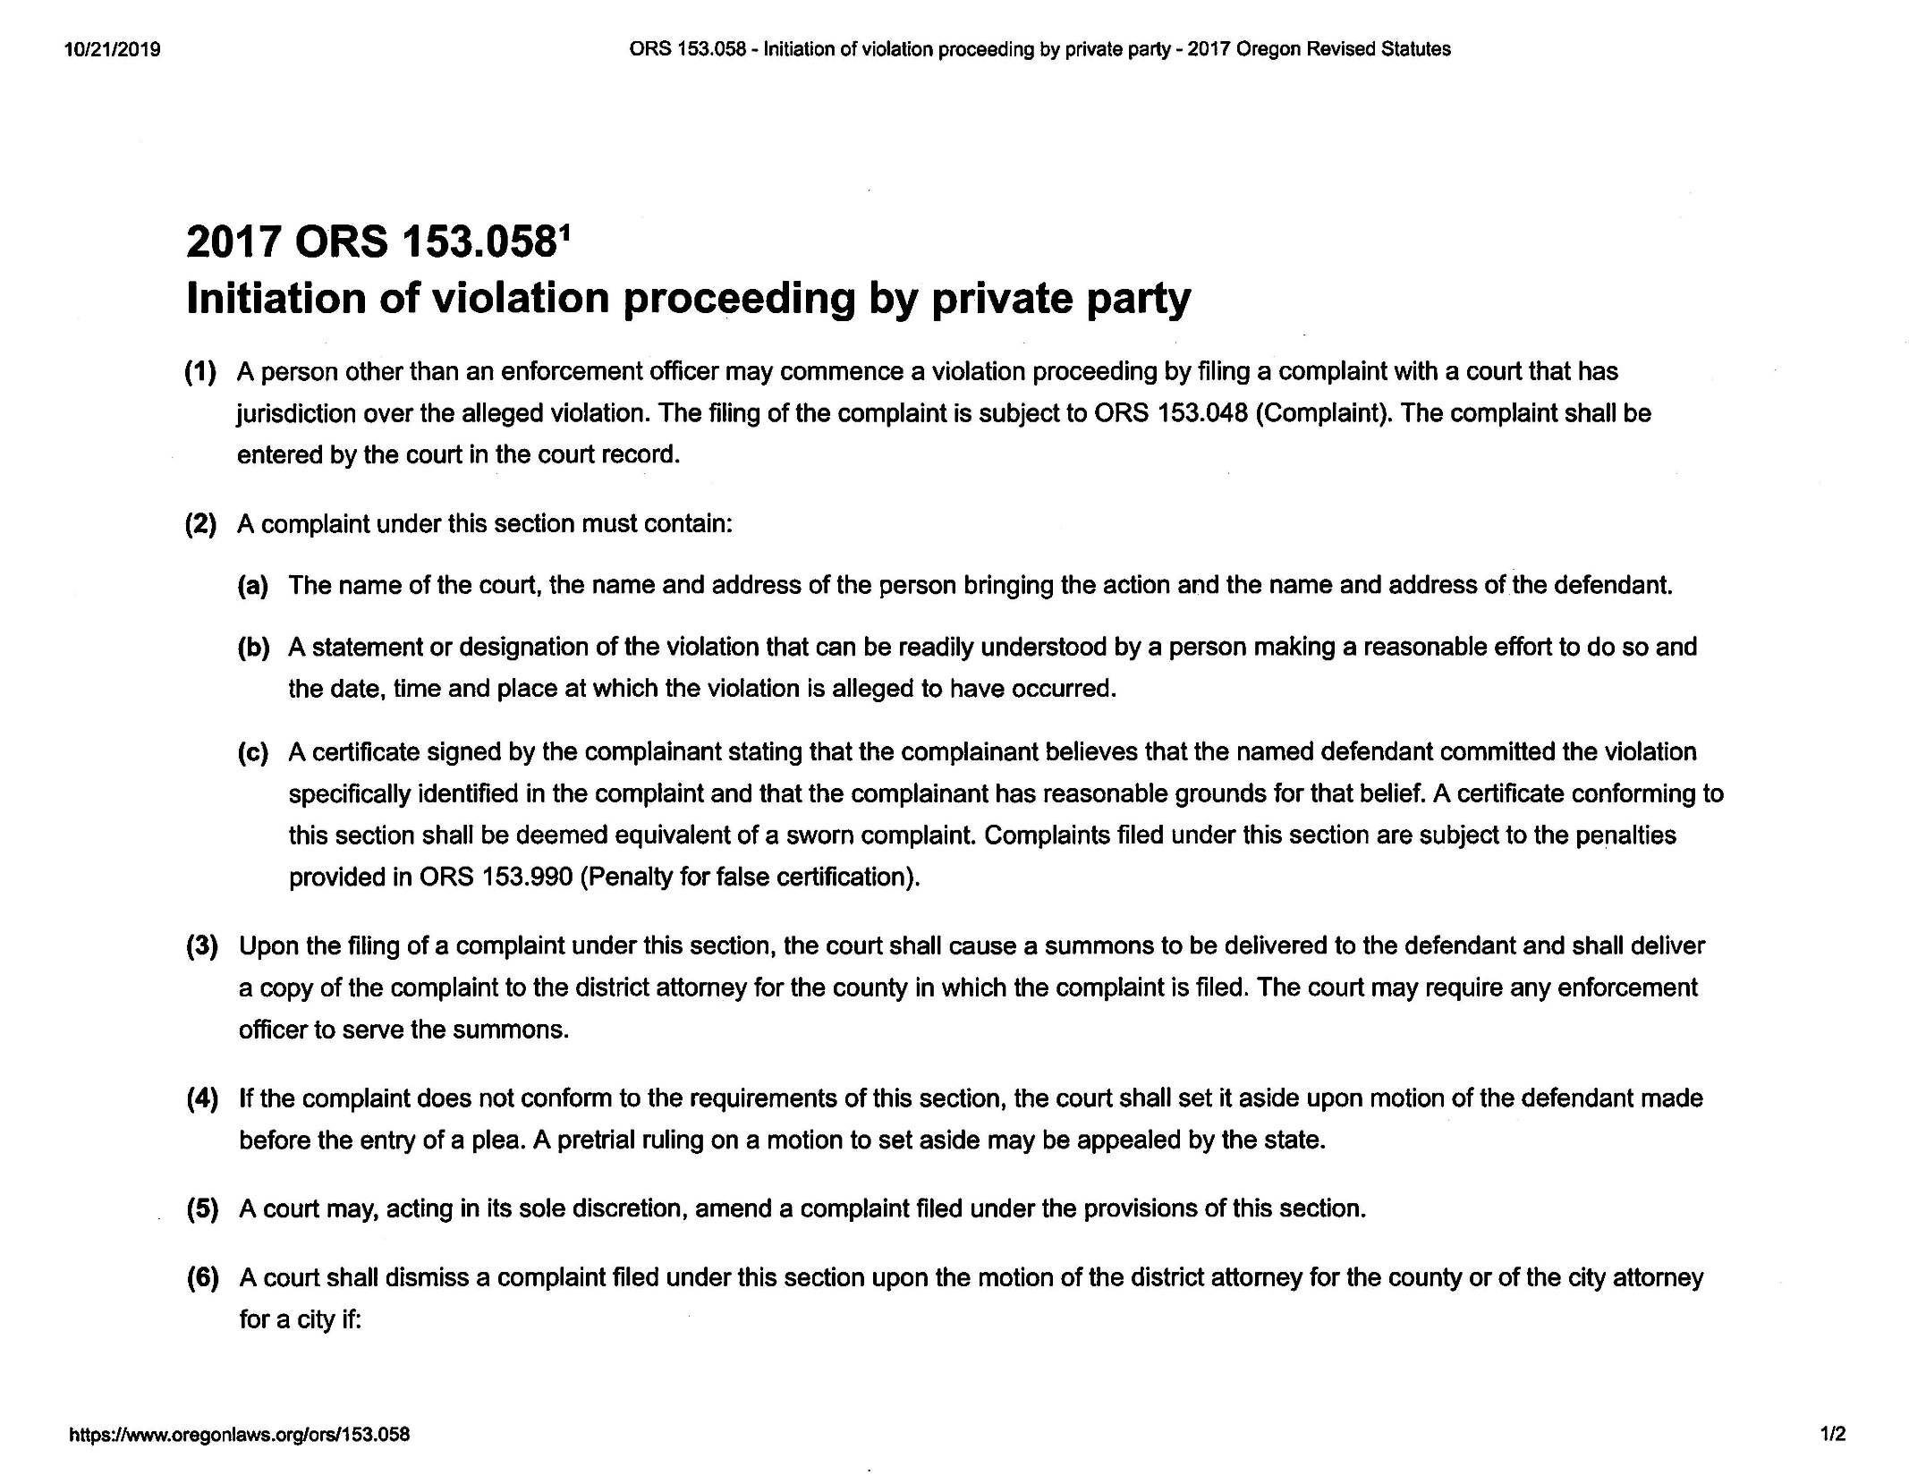

Slide 44
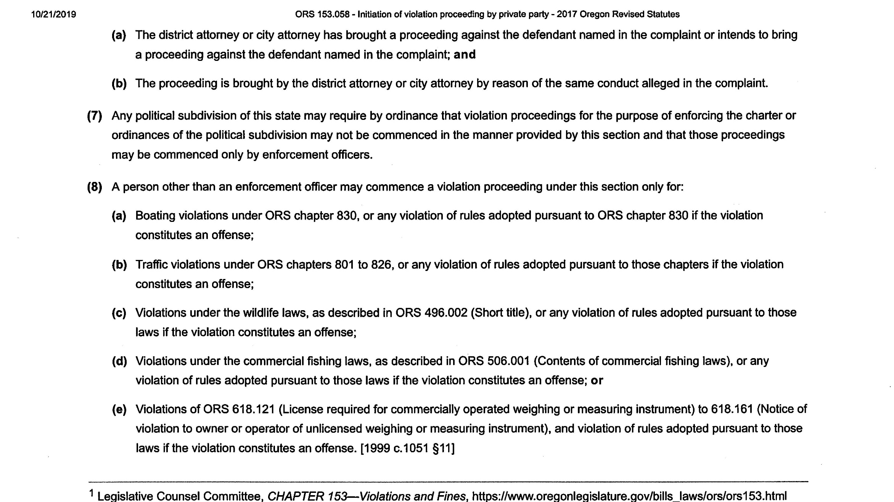

Slide 45
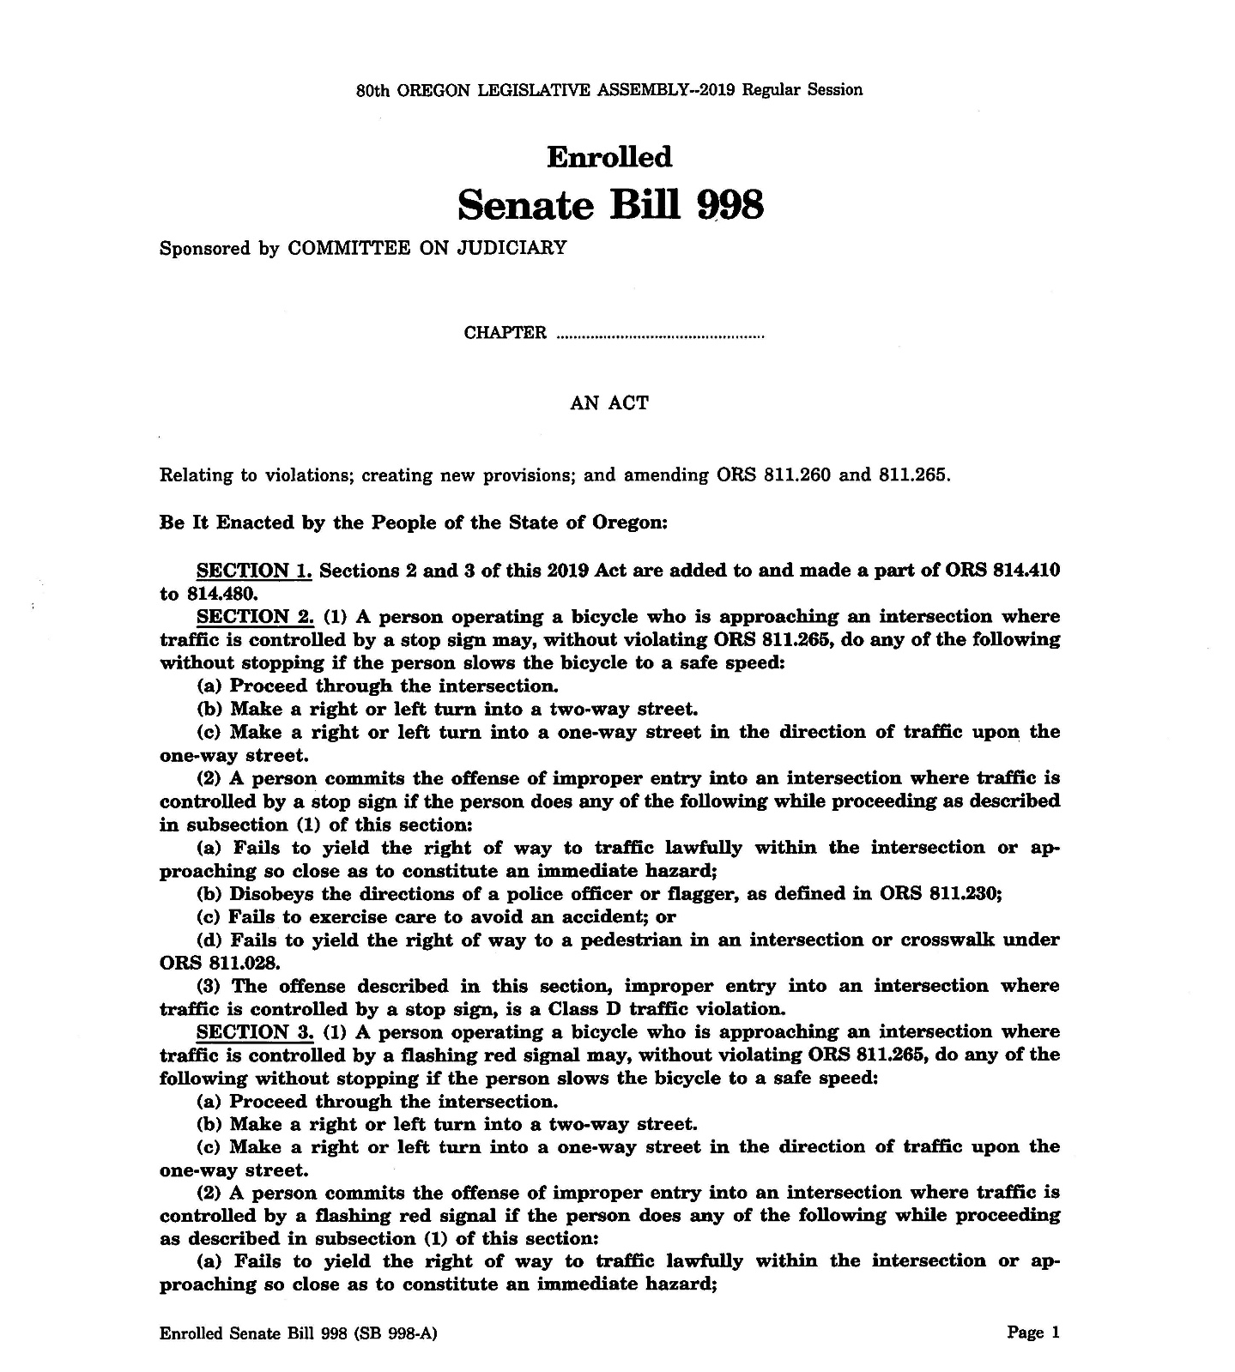

Slide 46
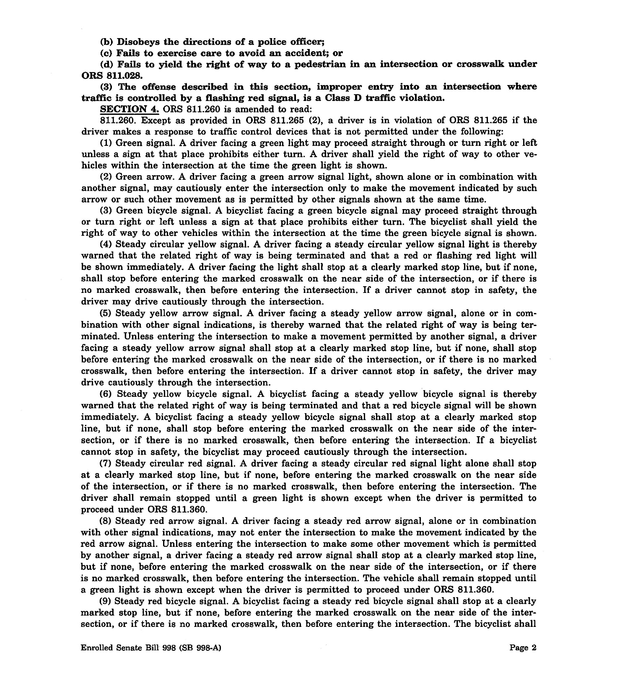

Slide 47
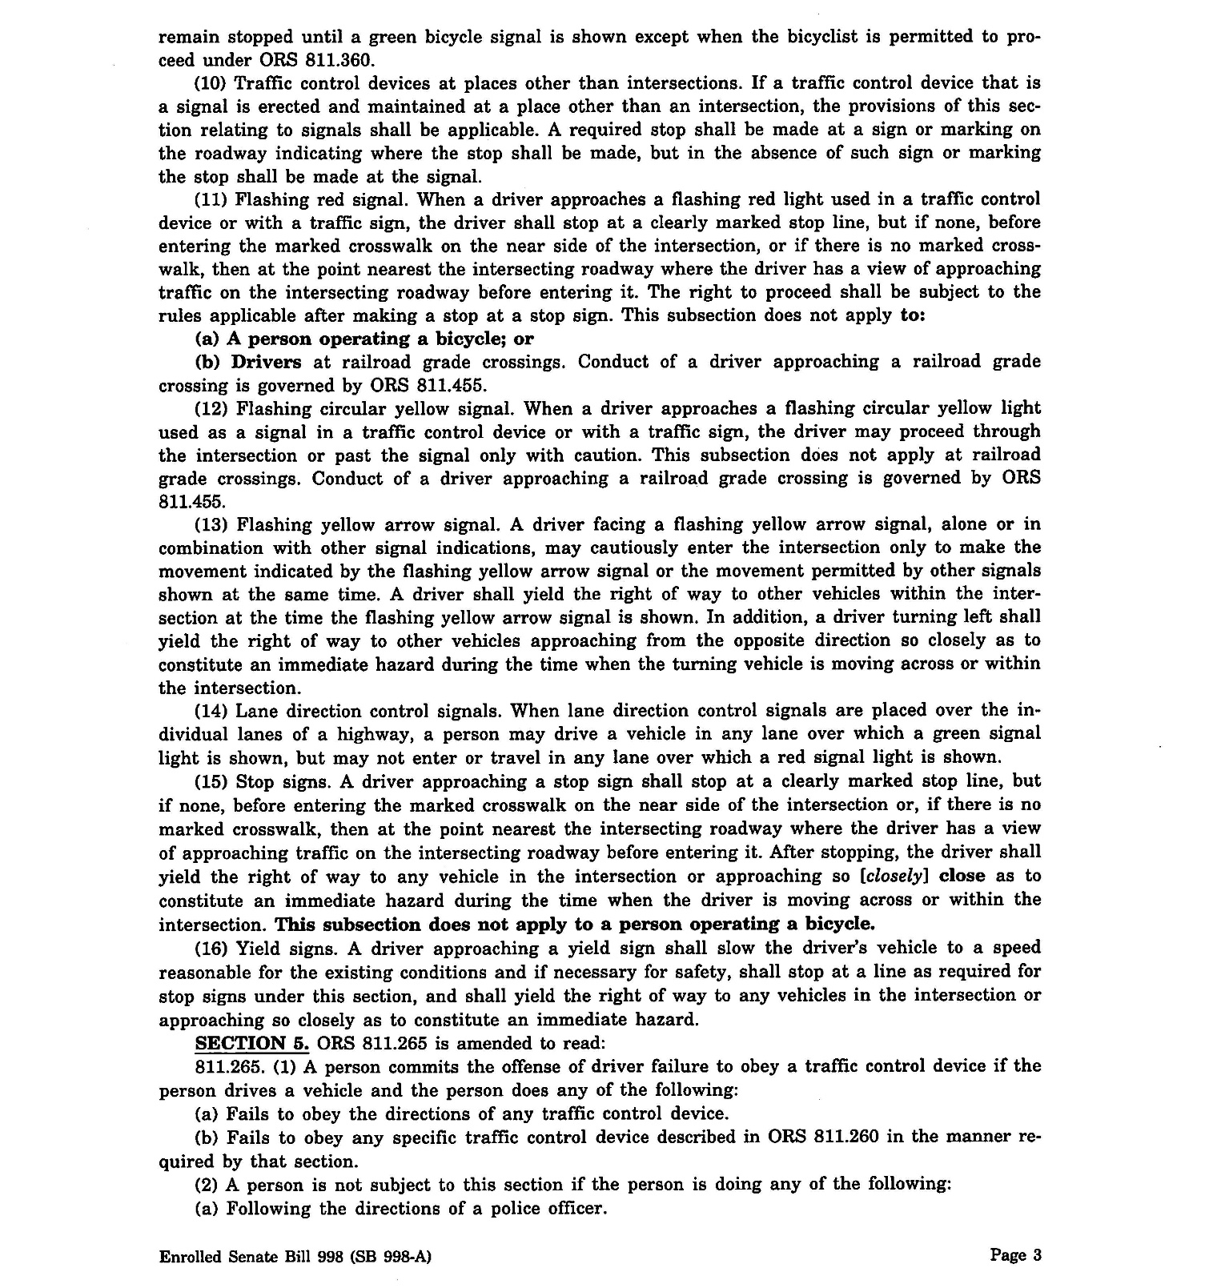

Slide 48
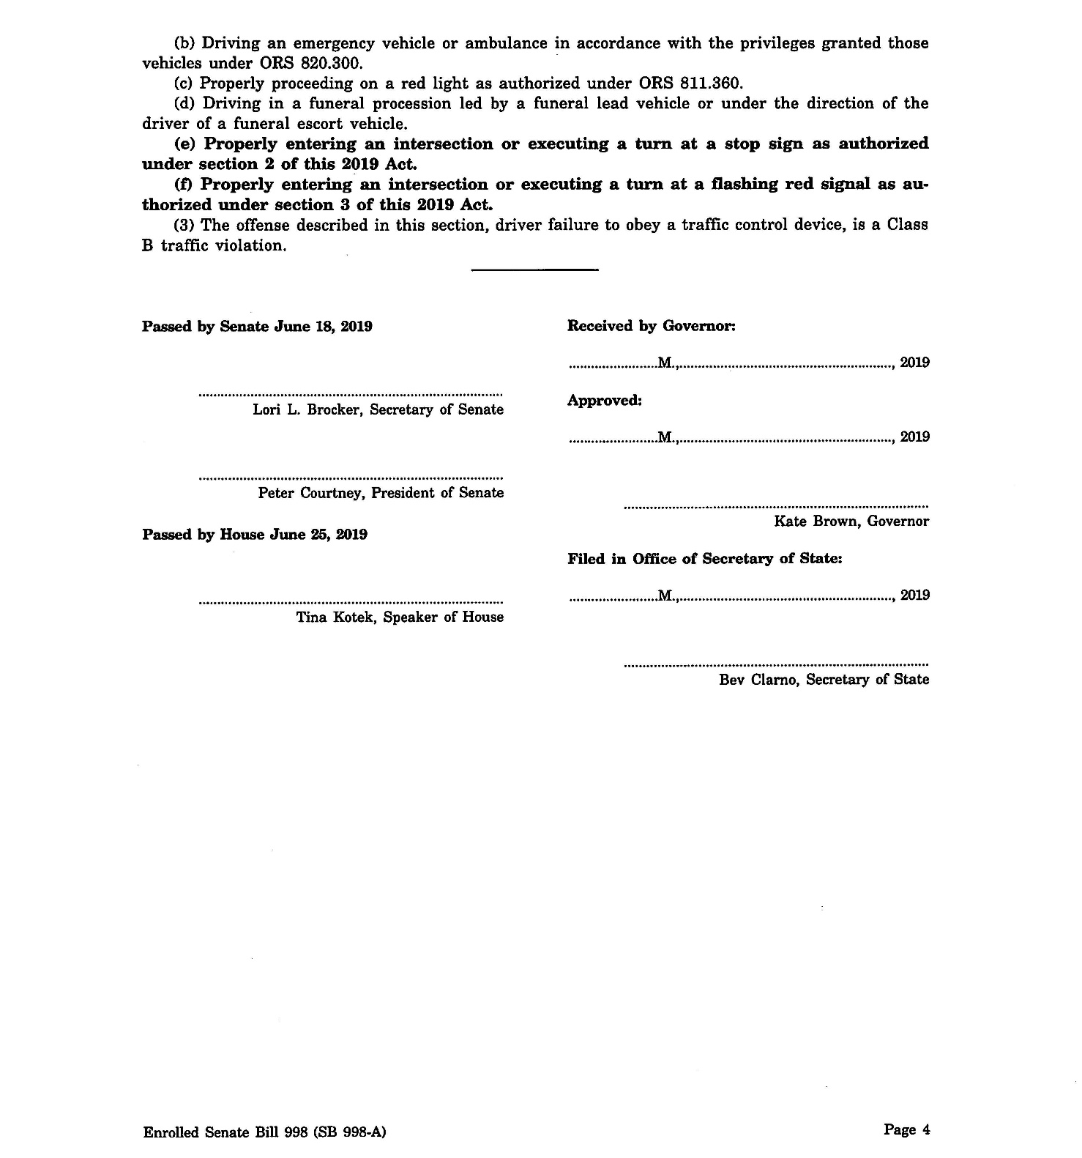

Slide 49
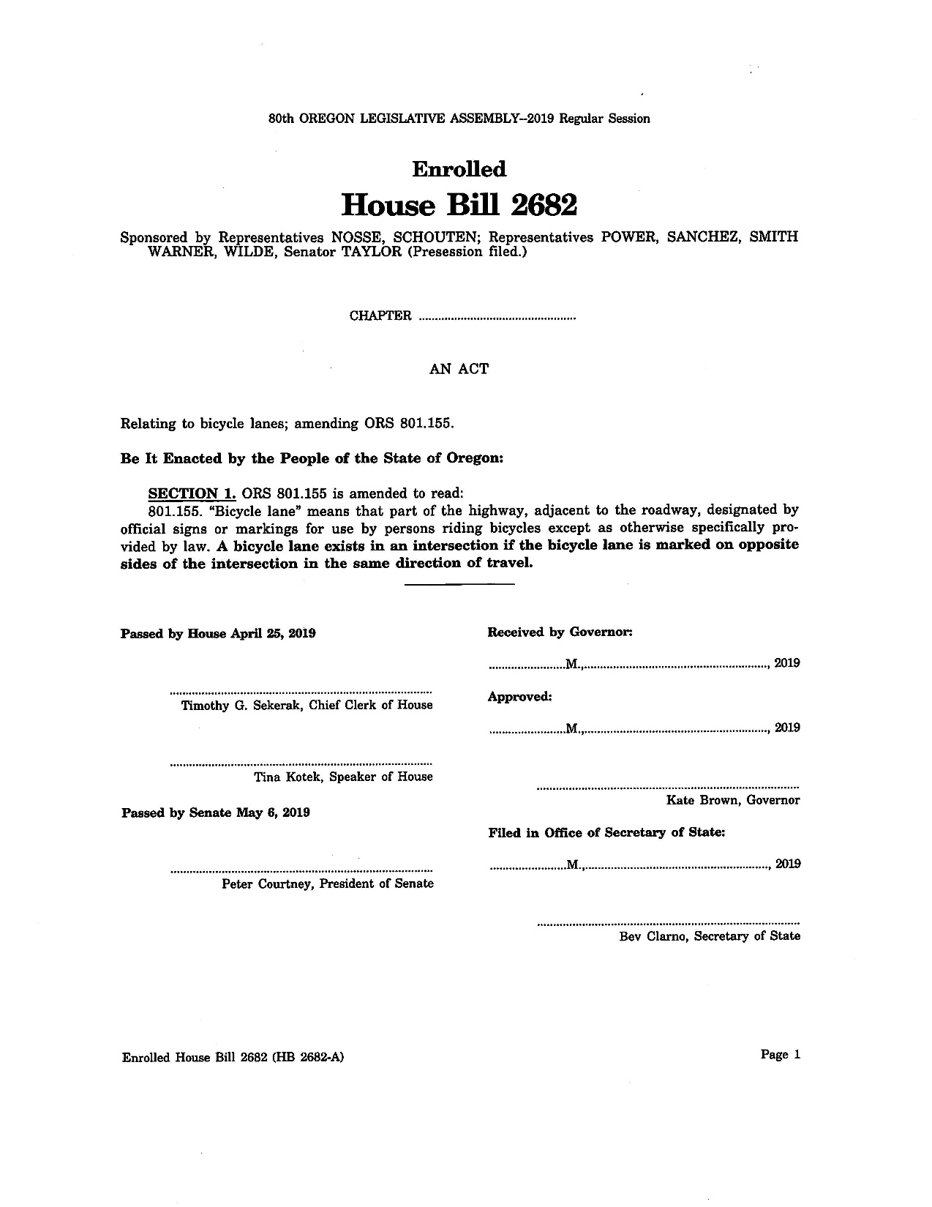

Slide 50
City and County Codes in Oregon: Albany
Albany Municipal Code
13.28.010 Use of sidewalks.
Pedestrians shall not use any roadway for travel when sidewalks abutting the same are available. (Ord. 2751 § 26, 1957)
13.28.020 Crossing at right angles.
No pedestrian shall cross a street at any places other than by a route at right angles to the curb or by the shortest route to the opposite curb except in a marked crosswalk. (Ord 2751 § 27, 1957).
13.28.030 Use of crosswalk required.
No pedestrian shall cross a street other than within a crosswalk in blocks with marked crosswalks (Ord. 2751 § 28, 1957)

Slide 51
City and County Codes in Oregon: Ashland
Ashland Municipal Code
11.08.110 Pedestrian.
Means a person afoot (Ord. 1557 S2(10), 1968)
11.44.010 Use of sidewalks.
Pedestrians shall not use a roadway for travel when abutting sidewalks are available for doing so. (Ord. 1557 S22, 1968)
11.44.020 Crossing at right angles.
No pedestrian shall cross a street at any place other than by a route at right angles to the curb or by the shortest route to the opposite curb except in a marked crosswalk. (Ord. 1557 S22, 1968).
11.40.030 Crosswalk – Use required.
In blocks with marked crosswalks, no pedestrians shall cross a street other than within a crosswalk. (Ord. 1557 S23, 1968)

Slide 52
City and County Codes in Oregon: Astoria
Astoria City Code
6.150 Crossing at Right Angles.
No pedestrian may cross a street at a place other than by a route at right angles to the curb or by the shortest route to the opposite curb except in a marked crosswalk.
6.155 Pedestrians Must Use Crosswalks.
In blocks where marked crosswalks are established, no pedestrians may cross the street other than within a marked crosswalk.

Slide 53
City and County Codes in Oregon: Beaverton
Beaverton Municipal Code
6.02.500
A pedestrian shall not use a street or the shoulder of a street for travel when a sidewalk is available.
6.02.510
No pedestrian shall cross a roadway outside of a marked crosswalk if within 150 feet of a marked crosswalk. [BC 6.02.510, amended by Ordinance No. 3883, 2/14/94]
6.02.520
A pedestrian shall cross a street at a right angle, unless crossing within a crosswalk.

Slide 54
City and County Codes in Oregon: Eugene
Eugene City Code
5.425 Right Angles.
A pedestrian shall cross a street at a right angle, unless crossing within a crosswalk. (Section 5.425, formerly section 5.470, renumbered by Ordinance No. 17690, enacted June 28, 1976.)

Slide 55
City and County Codes in Oregon: Gresham
Gresham Municipal Code
Section 8.55.010 Pedestrians.
(1) Pedestrians shall cross a street at a right angle, unless crossing within an angled, marked crosswalk.
(2) A pedestrian commits the offense of failure to use a crosswalk if:
(a) the pedestrian crosses a street other than within a crosswalk in blocks with marked crosswalks; or
(b) the pedestrian crosses a street within 150 feet of a marked crosswalk.
(3) Exceptions. The provisions of this section regulating pedestrian use of the streets do not apply to employees of the city, county, state, or public utility while engaged in their official duties.
(4) Failure to use a crosswalk is a Class B violation. (Ord. No. 1507, Amended, 09/19/200; Ord. No. 1268, Amended, 12/17/1992)

Slide 56
City and County Codes in Oregon: Milwaukie
Milwaukie Municipal Code
Chapter 10.24 Pedestrians.
10.24.010 Regulations.
(A) Pedestrians shall not use any roadway for travel when abutting sidewalks are available.
(B) No pedestrian shall cross a street other than within a crosswalk in blocks with marked crosswalks or if within one hundred fifty feet of a marked crosswalk.
(C) A pedestrian shall cross a street at a right angle, unless crossing within a crosswalk.
(D) Pedestrians shall move, wherever practicable upon the right half of the sidewalk. (Ord. 1360 § 5, 1977)

Slide 57
City and County Codes in Oregon: Oregon City
Oregon City Municipal Code
Title 10 Vehicles And Traffic.
Chapter 10.28 Pedestrians.
10.28.010 Jaywalking.
It is unlawful for any pedestrians to cross any of the streets in the city at any other place than the regular intersection crossing in line with the property line of the street, upon an area which would be covered by the sidewalk if extended. (Prior code §10-2-5)

Slide 58
City and County Codes in Oregon: Portland (1/2)
Portland City Code
16.70.200 Pedestrians.
16.70.210 Must Use Crosswalks.
No pedestrians may cross a street other than within a crosswalk if within 150 feet of a crosswalk.
16.70.220 Must Cross at Right Angles.
A pedestrian must cross a street at right angles unless crossing within a crosswalk.
16.70.230 To Obey Directions of School Traffic Patrol and Crossing Guard.
At intersections where a member of the school traffic patrol or crossing guard is stationed for the safety of school children, all pedestrians must obey the directions of such school tragic patrol member or crossing guard. It is unlawful for any pedestrian to cross at any intersection where such patrol member or crossing guard is stationed contrary to the direction of such school traffic patrol member or crossing guard.
16.70.240 Bridge Railings.
No pedestrians may sit, stand on, or lean their torso over a Willamette River bridge railing unless engaged in a bridge maintenance work or otherwise authorized by an appropriate government agency.

Slide 59
City and County Codes in Oregon: Portland (2/2)
16.70.750 Penalty.
(Amended by Ordinance Nos. 165987 and 176394, effective April 17, 2002.)
(A) Except as provided below, violation of this Chapter is an infraction punishable by a fine not to exceed $150.
(B) Violation of Sections 16.20.470, 16.70.510 A, 16.70.210, 16.70.220 and 16.10.060, is punishable by a fine of not more than $500, or by imprisonment not exceeding 10 days or both.

Slide 60
City and County Codes in Oregon: Sandy
Sandy City Code
10.34.010 Unlawful street obstruction.
(A) A person commits the offence of unlawful street obstruction if the person obstructs the free movement of vehicles or pedestrians using the public right-of-way.
(B) Section 10.34.010 does not apply to city, county, state or public utility employees engaged in their lawful duties, or persons engaged in construction work pursuant to a development or building permit.
(C) Unlawful street obstruction is a Class B infraction. (Ord. 98-15 § 1 (part), 1998.)
10.32.010 Use of sidewalks.
A pedestrian shall not use a roadway for travel when a sidewalk is available. (Ord. 13-73 § 36, 1973.)
10.32.030 Right angles.
A pedestrian shall cross at a right angle, unless crossing with a crosswalk. (Ord. 13-73 § 38, 1973.)
10.30.040 Obedience to traffic lights.
At an intersection where a pedestrian control light is in operation, no pedestrian shall start to cross the street except when the walk signal is illuminated. Where only vehicle control lights are in operation, no pedestrian shall start to cross the street except when the green light is illuminated. (Ord. 13-73 § 39, 1973.)

Slide 61
City and County Codes in Oregon: Scappoose
Scappoose Municipal Code of Ordinances
11.04.240 Pedestrians – Use of crosswalks required.
No pedestrian shall cross a street other than within a crosswalk in block with marked crosswalks, or if within one hundred fifty feet of a marked crosswalk. (Ord. 516 § 23,1986)
11.04.250 Street crossing – Right angles
A pedestrian shall cross a street at a right angle, unless crossing within a crosswalk. (Ord. 516 § 24,1986)
11.04.110 Obstructing streets.
No unauthorized person shall obstruct the free movement of vehicles or pedestrians using the streets. (Ord. 516 § 11,1986)

Slide 62
City and County Codes in Oregon: Springfield
Springfield Municipal Code
6.410 Pedestrians.
The operator of a bicycle shall give right-of-way at all times to a pedestrian proceeding lawfully, regardless of when and there the bicycle is being operated.
6.110 Obstructing Streets.
Except as this code provides to the contrary, no person shall place, park, deposit, or leave upon any street or other public way, sidewalk, or curb any vehicle article, thing, or material which in any way prevents, interrupts, impedes, or obstructs the free passage of pedestrians or vehicular traffic, or obstructs a driver’s view of traffic or official control device.
6.115 Use of Sidewalks.
Pedestrians shall not use any roadway for travel when abutting sidewalks are available.
6.120 Play Vehicles Restricted.
No person upon roller or in-line skates, or riding in or by means of any coaster, sled, toy vehicle, or similar device, shall go upon any street except to cross at a crosswalk.

Slide 63
City and County Codes in Oregon: St. Helens
St. Helens Municipal Code
10.04.250 Pedestrians must use crosswalks.
No pedestrians shall cross a street other than within a crosswalk in block with marked crosswalks or if within 150 feet of a marked crosswalk. (Ord. 2274 § 25, 1978)
10.04.260 Right angles.
A pedestrian shall cross a street at a right angle unless crossing within a crosswalk. (Ord. 2274 § 26, 1978)

Slide 64
City and County Codes in Oregon: Stayton
Stayton City Code
10.32.810 Crossing Streets at Right Angles.
A pedestrian shall cross a street at right angles unless crossing within a marked crosswalk. (Ord. 667, section 1 [part], 1989)

Slide 65
City and County Codes in Oregon: Tigard
Tigard Municipal Code
10.32.060 Use of Sidewalks.
Pedestrians shall not use any roadway for travel when abutting sidewalks are available. (Ord. 70-41 Ch. 8 §6, 1970)
10.32.235 Use of Crosswalks (Jaywalking).
(a) No pedestrians may cross the street or roadway other than within a crosswalk if they are within 100 feet of a crosswalk.
(b) A pedestrian shall cross a street or a roadway at a right angle unless crossing within a crosswalk.

Slide 66
City and County Codes in Oregon: Troutdale
Troutdale City Ordinances
10.20.010 Use of crosswalks required.
No pedestrian shall cross a street other than within a crosswalk in blocks with marked crosswalks or if within one hundred fifty feet of a marked crosswalk. Pedestrians shall not use a roadway for travel when abutting sidewalks are available. (Ord. 352-0 § 2 (7.10.165), 1981)
10.20.020 Crossing streets at right angles.
A pedestrian shall cross a street at a right angle, unless crossing within a crosswalk. (Ord. 352-0 § 2 (7.10.170), 1981)

Slide 67
City and County Codes in Oregon: West Linn
West Linn Municipal Code
08.02.120
(1) No pedestrian shall;
(2) Use any roadway for travel when sidewalks abutting the same are available; or
(3) Cross a street at any place other than in a marked crosswalk or by the shortest route to the opposite curb if no crosswalks are located within the block of the street being crossed. (Ord. 2951 § (part), 1996)
Violations: Violations of the Section may upon conviction thereof, be punished by a fine not to exceed $100. In addition thereto, the Municipal Judge may prohibit the operation of the device used in the violation for a period not to exceed 30 days. In such event, the Chief of Police shall be directed to impound the device, and retain it for the period that the operation is prohibited. An officer who issues a citation to a person for operating a device during a period of prohibited operations as ordered by the Municipal Judge, or to a person previously convicted of a violation of this Section during the preceding twelve-month period, may impound the subject device and dispose of it in accordance with the procedures in this Code for disposal of personal property, if the person is found guilty of the second offense. (Ord. 3098 § 1, 2001: Ord. 2951 § (part), 1996)

Slide 68
City and County Codes in Oregon: Woodburn
Woodburn City Ordinances
Pedestrians
Section 32. Right Angles.
A pedestrian shall cross a street at a right angle, unless crossing within a crosswalk.
Section 33. Use of Available Crosswalk.
No pedestrian shall cross a street other than within a crosswalk in blocks with marked crosswalks or if within 150 feet of a marked crosswalk.

Slide 69
City and County Codes in Oregon: Yamhill
Yamhill Active Municipal Code
6.08.090 Pedestrians Must Use Crosswalks.
No pedestrian shall cross a street other than within a crosswalk in blocks with marked crosswalks, or if within 150 feet of a marked crosswalk. (Ord. 314, § 25, 1977)
6.08.100 Right Angles.
A pedestrian shall cross a street at a right angle unless crossing within a crosswalk. (Ord. 314 § 26, 1977)

